Slide 1
Econ 106
Lecture 4
Fall 2024
Large part of these slides are adapted from Nick Hagerty at Montana State University and Introduction to Data Science by Rafael A. Irizarry, used under CC BY-NC-SA 4.0, and “Data Science for Economists” by Grant R. McDermott, used under the MIT License.
Notes:
Hi, and welcome R basics. Today we’re going to be discussing how to use the R programming language and the RStudio interface to read and subset tabular data.

Slide 2
Reminders
Lab 1 will be posted Sunday, due one week later
one-page writeup with tables
R script
https://pollev.com/vsovero

Slide 3

Interested in Grad School?

Slide 4
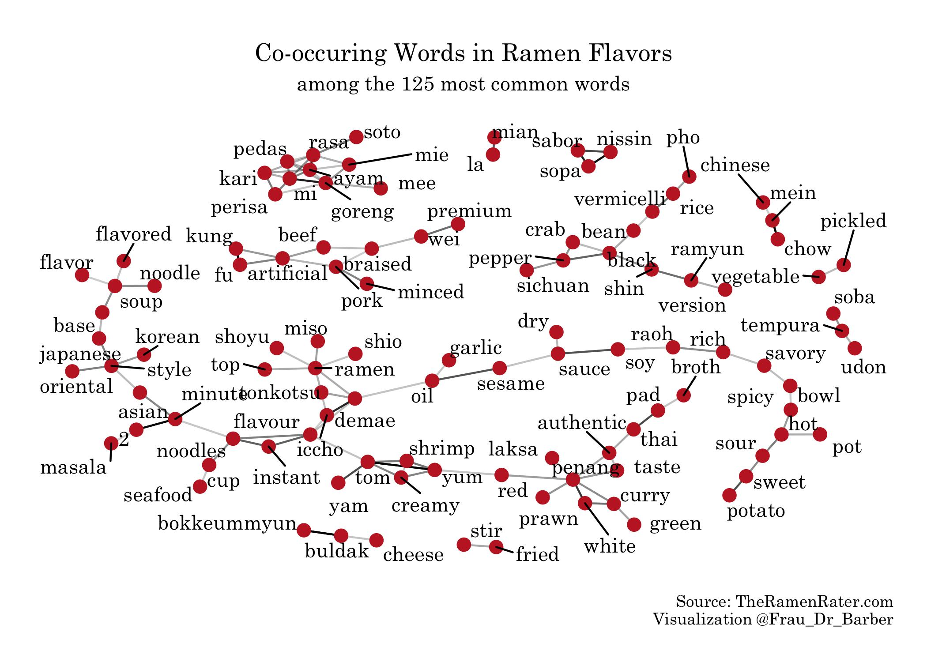
#tidytuesday
data source
code to generate graph

Slide 5
Outline
summary tables
frequency tables
Notes:
In brief, we’ll
1. Introduce the R programming language and the RStudio interface
2. Discuss how operators and functions work
3. Investigate the structure of data frames

Slide 6
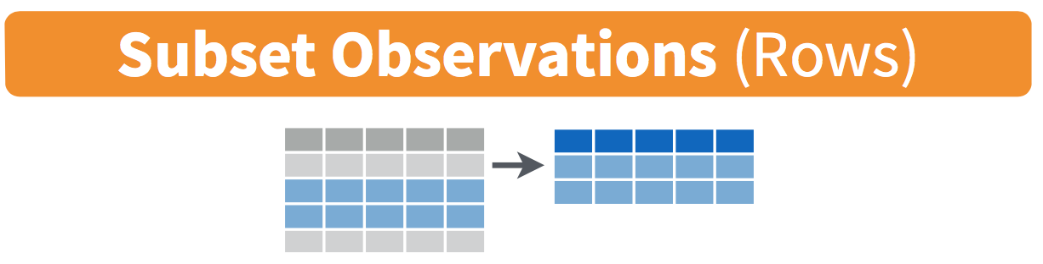
filter()

Slide 7
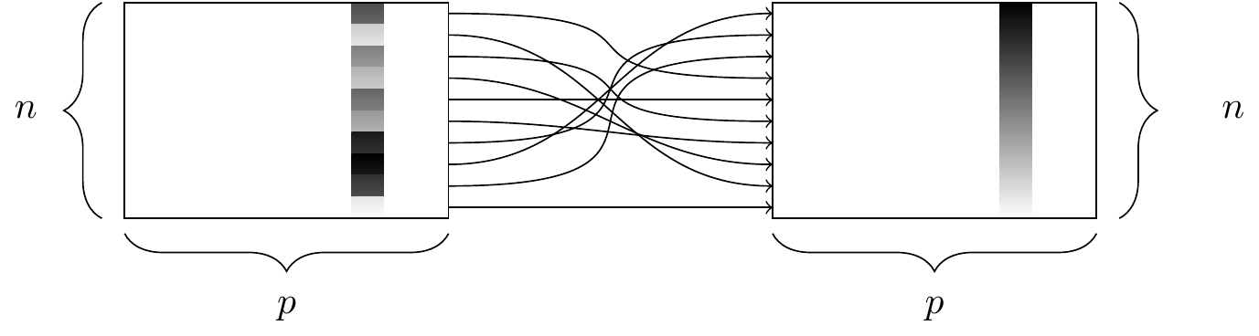
arrange()
Notes:
When making these summary tables, the data don’t always appear in the order that we would like.
The arrange() function orders the results in ascending order
It takes a variable as input
If you want to arrange them in descending order, wrap the variable name in the desc() function
The output is a table with the same data, but ordered in the way you specified.
Let’s see how this works:
Demo:
#Ascending order
surveys %>%
count(sex) %>%
arrange(n)
#descending order
surveys %>%
count(sex) %>%
arrange(desc(n))

Slide 8
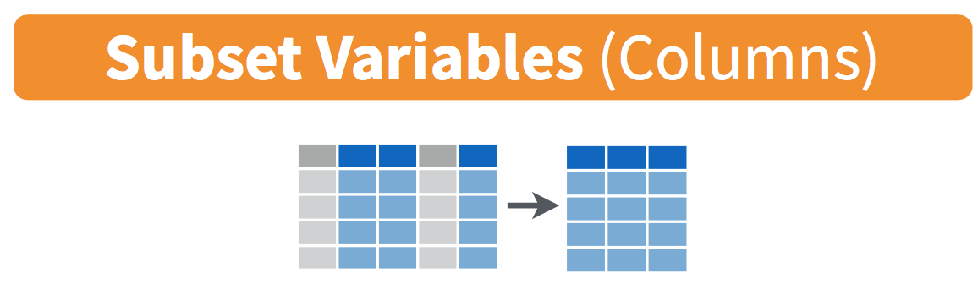
select()
Notes:
Now that we have the data loaded, let’s manipulate it with our first verb: select
Select picks columns from a data frame
It takes a tibble and a list of column names as input
And its output is a tibble with only the columns you selected
Let’s see an example of how select works
Demo 3: select
select(surveys,
weight)
You can also use –weight, keep everything but exclude weight column.
Same as:
tibble(surveys$weight)
#You can also select multiple columns by separating other column names with a comma.
#Let’s say we have a collaborator who only wants the plot, species id, and weight data
select(surveys, plot_id, species_id, weight)

Slide 9
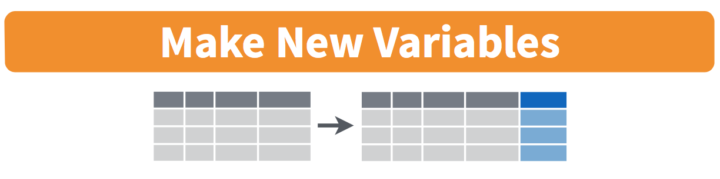
mutate()
Notes:
dplyr also allows you to create new columns using the mutate function
· Which creates a new column as defined by the input
· Mutate takes a tibble and an expression that names and defines the value of the new column
· This function outputs a tibble that includes the new column as defined in the input
· For example, the weight is currently in grams. We could create a new column called weight_kg that stores the weight in kilograms
· Let’s see how this works in practice
Demo 6:
To create a new column with mutate…
mutate(surveys, weight_kg = weight/1000)
same as
surveys %>%
mutate(weight_kg = weight/1000)

Slide 10
Recap: key dplyr verbs
**There are five key dplyr verbs that you need to learn.**
filter: Filter (i.e. subset) rows based on their values.
arrange: Arrange (i.e. reorder) rows based on their values.
select: Select (i.e. subset) columns by their names:
mutate: Create new columns.
summarize: Collapse multiple rows into a single summary value
https://pollev.com/vsovero

Slide 11
Summarizing Variables
How can we summarize/describe variables?
quantitative data
categorical data

Slide 12
Useful functions for quantitative variables
Center: mean(), median()
Spread: sd(), var()
Range: min(), max(),
Position: first(), last(),
Total: sum()

Slide 13

Creating a summary table
Notes:
Dplyr also has functions that make it easy to create summary tables
First let’s look at the summarize function
summarize applies a summary statistic to data
It takes a definition of a summary statistic as input
And outputs the summary statistic
Let’s look at how this works
Demo:
Suppose you would like to know the average weight for all animals in the dataset
#Overall mean weight
surveys %>%
summarize(mean_weight = mean(weight))
#remove NAs
surveys %>%
summarize(mean_weight = mean(weight, na.rm = TRUE))
na.rm is a logical value indicating whether NA values should be stripped before the computation proceeds.
Mean is a built-in function in base R

Slide 14
Creating a summary table
summarize()
Arguments: a specific summary statistic
e.g.: mean(), min(), max(), median(), sum()
Output: a table with the calculated summary statistic
Notes:
Dplyr also has functions that make it easy to create summary tables
First let’s look at the summarize function
summarize applies a summary statistic to data
It takes a definition of a summary statistic as input
And outputs the summary statistic
Let’s look at how this works
Demo:
Suppose you would like to know the average weight for all animals in the dataset
#Overall mean weight
surveys %>%
summarize(mean_weight = mean(weight))
#remove NAs
surveys %>%
summarize(mean_weight = mean(weight, na.rm = TRUE))
na.rm is a logical value indicating whether NA values should be stripped before the computation proceeds.
Mean is a built-in function in base R

Slide 15
Creating a summary table
height_summary <- starwars %>%
summarize(mean_height = mean(height))
the summarize function is similar to the mutate function
you have to provide a name (mean_height) for where the new information will be stored
Notes:
Dplyr also has functions that make it easy to create summary tables
First let’s look at the summarize function
summarize applies a summary statistic to data
It takes a definition of a summary statistic as input
And outputs the summary statistic
Let’s look at how this works
Demo:
Suppose you would like to know the average weight for all animals in the dataset
#Overall mean weight
surveys %>%
summarize(mean_weight = mean(weight))
#remove NAs
surveys %>%
summarize(mean_weight = mean(weight, na.rm = TRUE))
na.rm is a logical value indicating whether NA values should be stripped before the computation proceeds.
Mean is a built-in function in base R

Slide 16
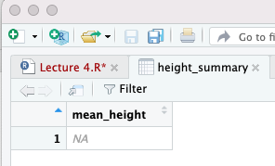
What happened?
height_summary <- starwars %>%
summarize(mean_height = mean(height))
Notes:
Dplyr also has functions that make it easy to create summary tables
First let’s look at the summarize function
summarize applies a summary statistic to data
It takes a definition of a summary statistic as input
And outputs the summary statistic
Let’s look at how this works
Demo:
Suppose you would like to know the average weight for all animals in the dataset
#Overall mean weight
surveys %>%
summarize(mean_weight = mean(weight))
#remove NAs
surveys %>%
summarize(mean_weight = mean(weight, na.rm = TRUE))
na.rm is a logical value indicating whether NA values should be stripped before the computation proceeds.
Mean is a built-in function in base R

Slide 17
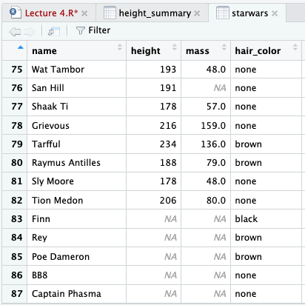
Missing Data is What Happened
R can’t compute the mean of a numeric vector if there are any missing values (NA)
We will have to tell it to ignore the rows that have missing values

Slide 18
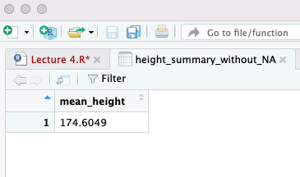
Fixed With an Additional Argument
height_summary_without_NA <- starwars %>%
summarize(mean_height = mean(height, na.rm = TRUE ))
Notes:
Dplyr also has functions that make it easy to create summary tables
First let’s look at the summarize function
summarize applies a summary statistic to data
It takes a definition of a summary statistic as input
And outputs the summary statistic
Let’s look at how this works
Demo:
Suppose you would like to know the average weight for all animals in the dataset
#Overall mean weight
surveys %>%
summarize(mean_weight = mean(weight))
#remove NAs
surveys %>%
summarize(mean_weight = mean(weight, na.rm = TRUE))
na.rm is a logical value indicating whether NA values should be stripped before the computation proceeds.
Mean is a built-in function in base R

Slide 19
Base R vs. Dplyr
We could have also used Base R for this calculation
The code is actually a bit simpler
However, it’s going to store the information as a vector
height_summary_without_NA <- mean(starwars$height, na.rm = TRUE)
height_summary_without_NA <- starwars %>%
summarize(mean_height = mean(height, na.rm = TRUE ))

Slide 20
Creating a less silly summary table
We can summarize more than one variable
Add a comma, then write out the next statistic
ht_and_wt_summary <- starwars %>%
summarize(mean_height = mean(height , na.rm=TRUE),
mean_weight = mean(mass , na.rm=TRUE)
)
Notes:
Dplyr also has functions that make it easy to create summary tables
First let’s look at the summarize function
summarize applies a summary statistic to data
It takes a definition of a summary statistic as input
And outputs the summary statistic
Let’s look at how this works
Demo:
Suppose you would like to know the average weight for all animals in the dataset
#Overall mean weight
surveys %>%
summarize(mean_weight = mean(weight))
#remove NAs
surveys %>%
summarize(mean_weight = mean(weight, na.rm = TRUE))
na.rm is a logical value indicating whether NA values should be stripped before the computation proceeds.
Mean is a built-in function in base R

Slide 21
Exercise
Calculate median and mean mass for characters in Naboo.
What does this suggest about the distribution of mass?
https://pollev.com/vsovero
Notes:
Dplyr also has functions that make it easy to create summary tables
First let’s look at the summarize function
summarize applies a summary statistic to data
It takes a definition of a summary statistic as input
And outputs the summary statistic
Let’s look at how this works
Demo:
Suppose you would like to know the average weight for all animals in the dataset
#Overall mean weight
surveys %>%
summarize(mean_weight = mean(weight))
#remove NAs
surveys %>%
summarize(mean_weight = mean(weight, na.rm = TRUE))
na.rm is a logical value indicating whether NA values should be stripped before the computation proceeds.
Mean is a built-in function in base R

Slide 22
Summarizing Categorical Variables
Econ 101 recap: we summarize/describe categorical variables with frequency tables
wage | Score | Rating | Gender | educ
11.42 | 3 | average | male | 16
3.91 | 3 | average | female | 12
8.76 | 3 | average | male | 16
7.69 | 4 | above | male | 16
5 | 3 | average | female | 16
3.89 | 3 | average | female | 12
3.45 | 5 | above | female | 12
4.03 | 4 | above | male | 16
5.14 | 2 | below | male | 17
3 | 3 | average | male | 16
Value | Count
below | 1
average | 6
high | 3

Slide 23
Create a frequency table
count ()
Arguments: a categorical variable
Output: a table with the frequency of each value of the categorical variable

Slide 24
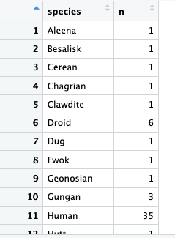
Species Frequency Table
species_frequency<- starwars %>%
count(species)

Slide 25
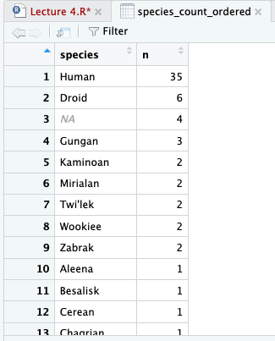
Species Frequency Table (ordered by frequency)
species_count_ordered<- starwars %>%
count(species) %>%
arrange(desc( n))

Slide 26
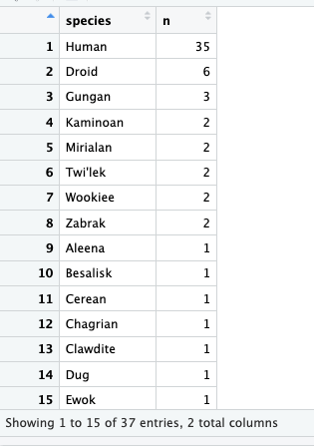
Species Frequency Table (remove NA)
species_count_remove_NA<- starwars %>%
count(species) %>%
arrange(desc( n)) %>%
filter(!is.na (species))

Slide 27
Shortening our tables with slice()
slice_head(n) select the first n rows
slice_tail(n) select the last n rows.
slice_sample(n) randomly select n rows.
slice_min(x, n) select n rows with the smallest values of variable x
slice_max(x, n) select n rows with the largest values of variable x

Slide 28
Top 10 List of Most Frequent Species
top_ten_species<- starwars %>%
filter(!is.na (species)) %>%
count(species) %>%
arrange(desc( n)) %>%
slice_head(n=10)

Slide 29
Exercise
filter out missing values of eye color
order the eye colors in a frequency table from highest to lowest frequency
report the top ten eye colors by frequency

Slide 30
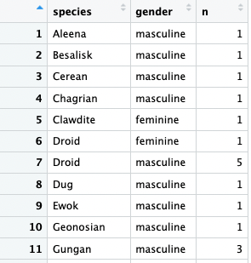
Frequency Table (two variables)
species_gender_frequency<- starwars %>%
count(species, gender)

Slide 31
Recap so far: How to Summarize/Describe Variables
Quantitative variables:
mean, median, etc.
use summarize()
Categorical variables:
frequencies (use count())

Slide 32
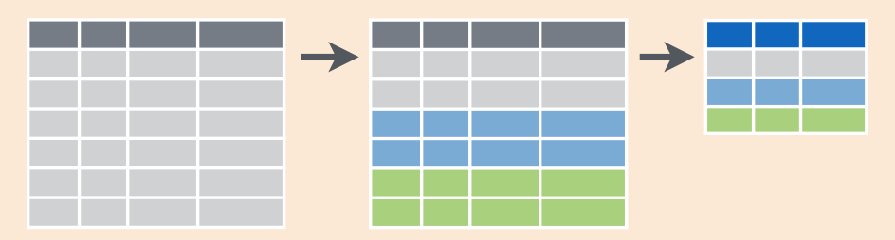
group_by()

Slide 33
Grouped summary table
group_by()
Arguments: set of variables
Output: a table with the calculated summary statistic for each combination of unique values in the variables inside group_by()
Notes:
You can also group by multiple variables. For example, it might make more sense to group M/F within a species.
Demo:
#Mean weight by sex
surveys %>%
group_by(sex, species_id) %>%
summarize(mean_weight = mean(weight, na.rm = TRUE))

Slide 34
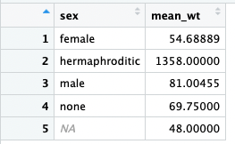
Grouped summary table
weight_by_sex <- starwars %>%
group_by( sex) %>%
summarize(mean_wt = mean(mass, na.rm = TRUE))
Output
Notes:
We’ve learned how to get a summary stats for the overall animals, but what if we want to know the summary for female group and male group separately?
We can use filter verb to get female subset and run a summary, and do it again for male. But it’s tedious. Then we can use group_by, it would tell R to summarize within groups instead of the entire population
However, using summarize alone isn’t that interesting. It would be much nicer if we could calculate summary stats for different categories within our dataset
Group_by groups data in the table by an attribute
It takes a tibble and a column with a categorical variable to group by
If you use it alone, the output is a tibble that looks a lot like the original, but has additional metadata that groups the observations as specified
If the grouped table is the input to summarize, the output changes to give you information about these subgroups
Let’s see how this works
Demo 7:
#Mean weight by sex
surveys %>%
group_by(sex) %>%
summarize(mean_weight = mean(weight, na.rm = TRUE))

Slide 35
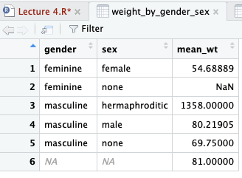
Grouped summary table (more than one group)
weight_by_gender_sex <- starwars %>%
group_by( gender, sex) %>%
summarize(mean_wt = mean(mass, na.rm = TRUE))
Output
what happened here?
Notes:
We’ve learned how to get a summary stats for the overall animals, but what if we want to know the summary for female group and male group separately?
We can use filter verb to get female subset and run a summary, and do it again for male. But it’s tedious. Then we can use group_by, it would tell R to summarize within groups instead of the entire population
However, using summarize alone isn’t that interesting. It would be much nicer if we could calculate summary stats for different categories within our dataset
Group_by groups data in the table by an attribute
It takes a tibble and a column with a categorical variable to group by
If you use it alone, the output is a tibble that looks a lot like the original, but has additional metadata that groups the observations as specified
If the grouped table is the input to summarize, the output changes to give you information about these subgroups
Let’s see how this works
Demo 7:
#Mean weight by sex
surveys %>%
group_by(sex) %>%
summarize(mean_weight = mean(weight, na.rm = TRUE))

Slide 36
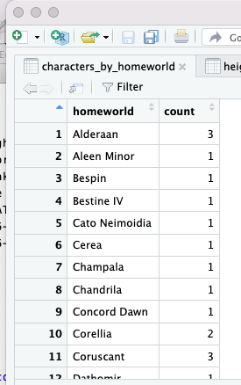
Using group_by() to Create a Frequency Table
characters_by_homeworld<- starwars %>%
group_by(homeworld) %>%
summarize(count=n())
Notes:
We’ve learned how to get a summary stats for the overall animals, but what if we want to know the summary for female group and male group separately?
We can use filter verb to get female subset and run a summary, and do it again for male. But it’s tedious. Then we can use group_by, it would tell R to summarize within groups instead of the entire population
However, using summarize alone isn’t that interesting. It would be much nicer if we could calculate summary stats for different categories within our dataset
Group_by groups data in the table by an attribute
It takes a tibble and a column with a categorical variable to group by
If you use it alone, the output is a tibble that looks a lot like the original, but has additional metadata that groups the observations as specified
If the grouped table is the input to summarize, the output changes to give you information about these subgroups
Let’s see how this works
Demo 7:
#Mean weight by sex
surveys %>%
group_by(sex) %>%
summarize(mean_weight = mean(weight, na.rm = TRUE))

Slide 37
Exercise
Let’s load some data from a tidytuesday challenge
we will use the read_csv() function from the tidyverse package
it can read in csv files from your computer or from a URL

Slide 38
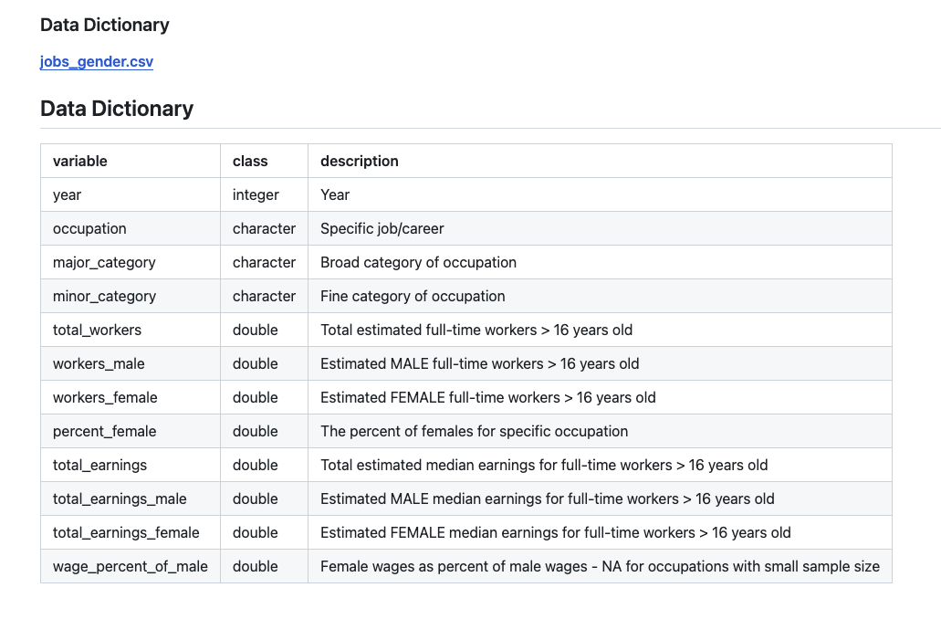
tidytuesday data

